Slide 1
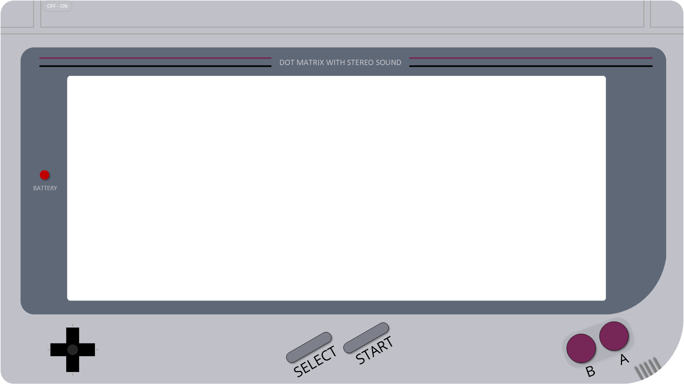











SQLBits – 8th March to 12th at the London ExCel
Load
Transform
Extract

Slide 2
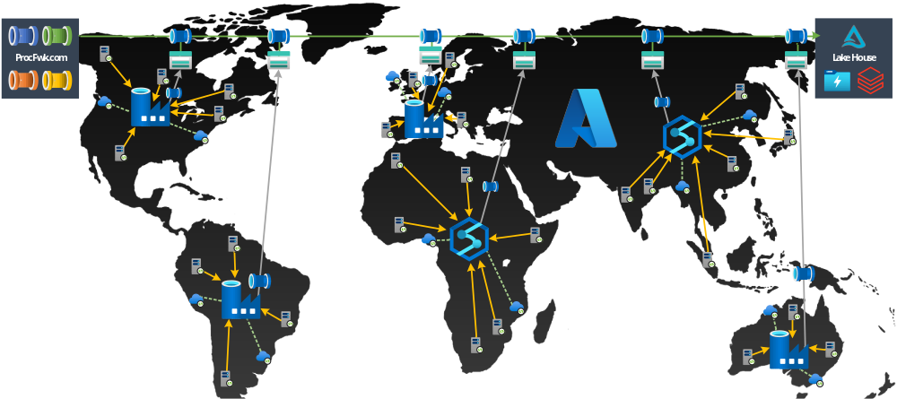
Azure Data Integration Pipelines - Advanced Design and Delivery

Slide 3
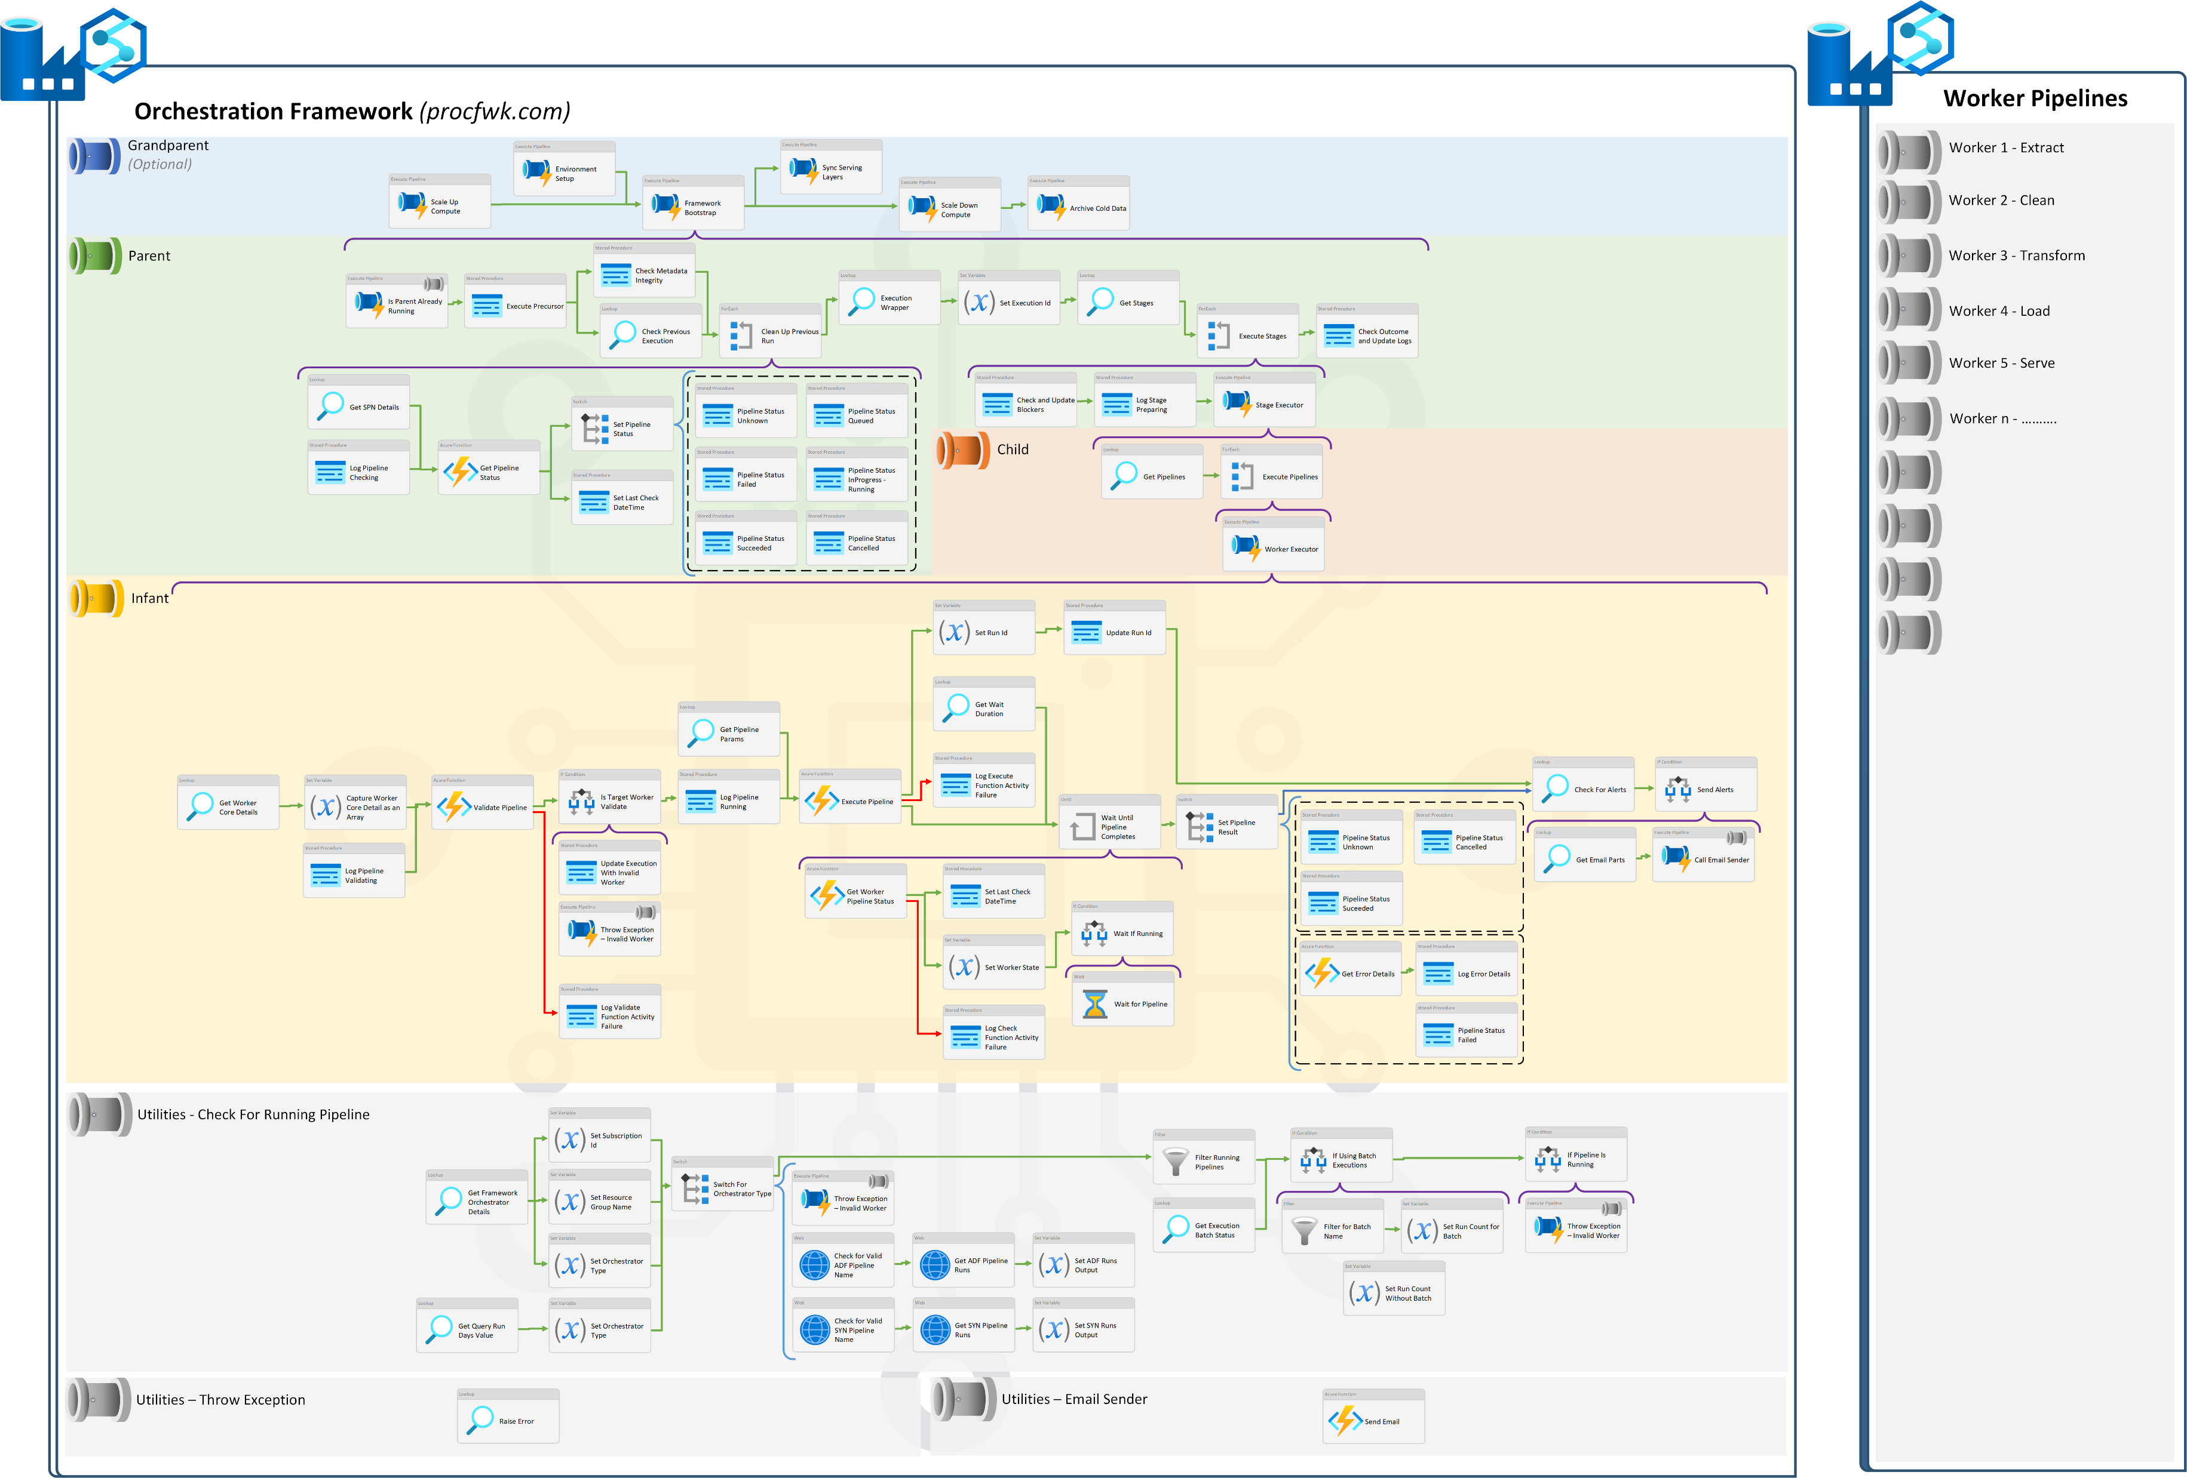
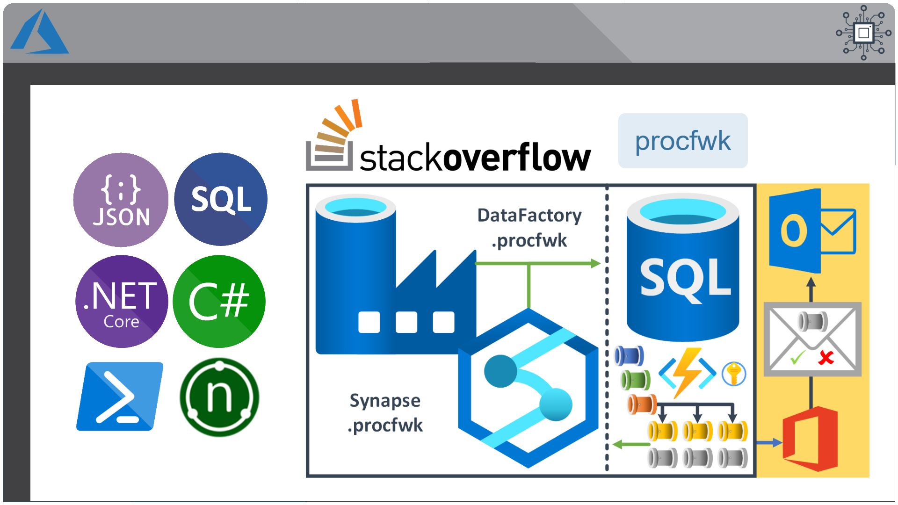
Creating a Metadata Driven Orchestration Framework Using Azure Data Integration Pipelines

Slide 4

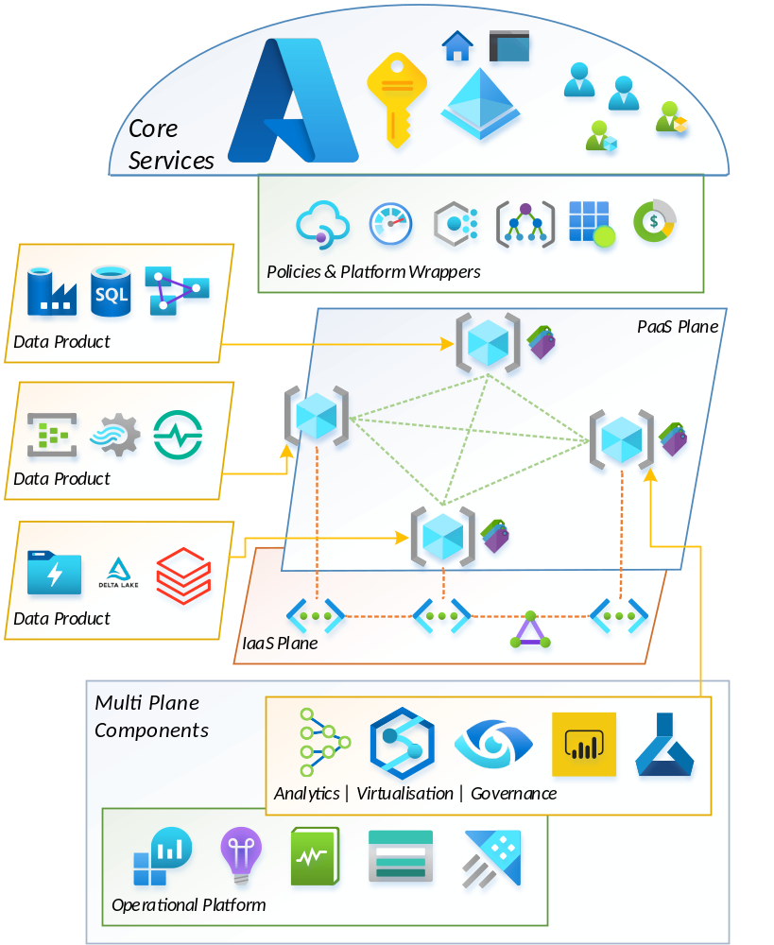


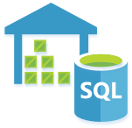











The Evolution of Data Platform Architectures in Azure - Lambda, Kappa, Delta, Data Mesh
Batch
Serve
Query
Speed
* Pre Delta-Lake
Batch
Ingestion
Consumption
Speed

Slide 5

Azure Data Integration Pipelines - Advanced Design and Delivery with Paul Andrew
SQLBits – 9th March – Online or In Person @ London Excel – Full Day of Training
mrpaulandrew.com

Slide 6

Azure Data Integration Pipelines - Advanced Design and Delivery with Paul Andrew
SQLBits – 9th March – Online or In Person @ London Excel – Full Day of Training
mrpaulandrew.com

Slide 7
Azure Data Integration Pipelines - Advanced Design and Delivery with Paul Andrew
SQLBits – 9th March – Online or In Person @ London Excel – Full Day of Training
mrpaulandrew.com

Slide 8




Azure Data Integration Pipelines - Advanced Design and Delivery with Paul Andrew
SQLBits – 9th March – Online or In Person @ London Excel – Full Day of Training
mrpaulandrew.com

Slide 9
Azure Data Integration Pipelines - Advanced Design and Delivery with Paul Andrew
SQLBits – 9th March – Online or In Person @ London Excel – Full Day of Training
mrpaulandrew.com

Slide 10
Azure Data Integration Pipelines - Advanced Design and Delivery with Paul Andrew
SQLBits – 9th March – Online or In Person @ London Excel – Full Day of Training
THANK YOU!

